Slide 1

Econometrics 2: Panel data
Hadi Movaghari
2022-2023

Slide 2
Types of data in econometrics
There are three types of data which econometricians might use for analysis:
Cross-sectional data
Time series data (e.g., daily, weekly, …)
Panel data (cross-sectional time series data / longitudinal data)
Balanced panel: Equal number of observation for all subjects
Unbalanced panel: Unequal number of observations
Econometrics 2: Panel data models
University of Glasgow
2022-2023

Slide 3
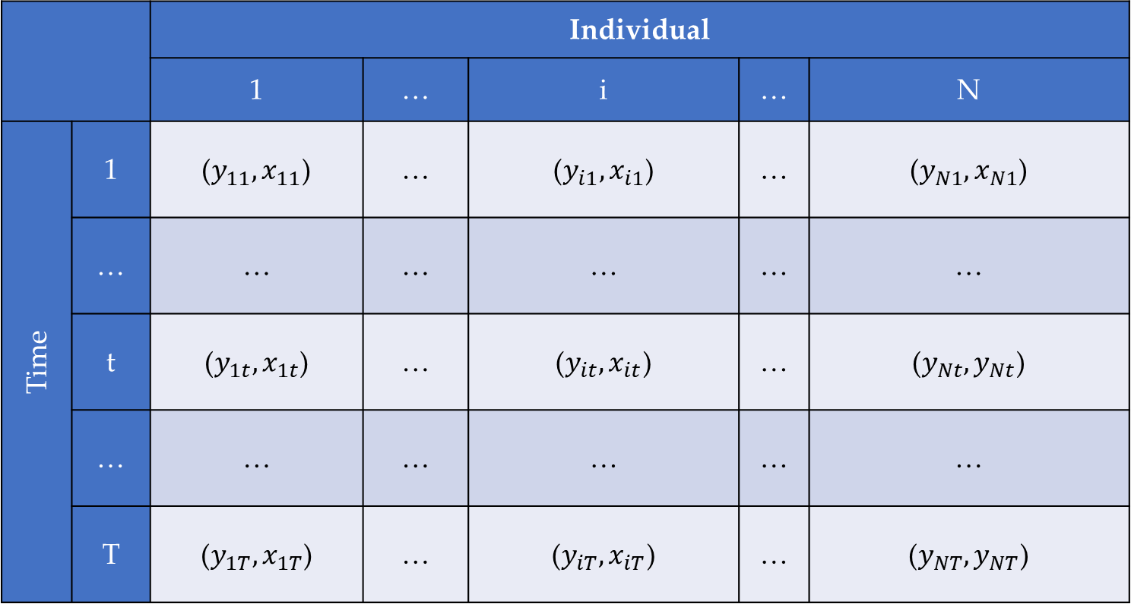
Types of data – Cont’d
 |  | Individual
 |  | 1 | … | i | … | N
Time | 1 | ($y_{11},x_{11}$) | … | ($y_{i1},x_{i1}$) | … | ($y_{N1},x_{N1}$)
 | … | … | … | … | … | …
 | t | ($y_{1t},x_{1t}$) | … | ($y_{it},x_{it}$) | … | ($y_{Nt},y_{Nt}$)
 | … | … | … | … | … | …
 | T | ($y_{1T},x_{1T}$) | … | ($y_{iT},x_{iT}$) | … | ($y_{NT},y_{NT}$)
Cross-sectional data
Time series data

Slide 4
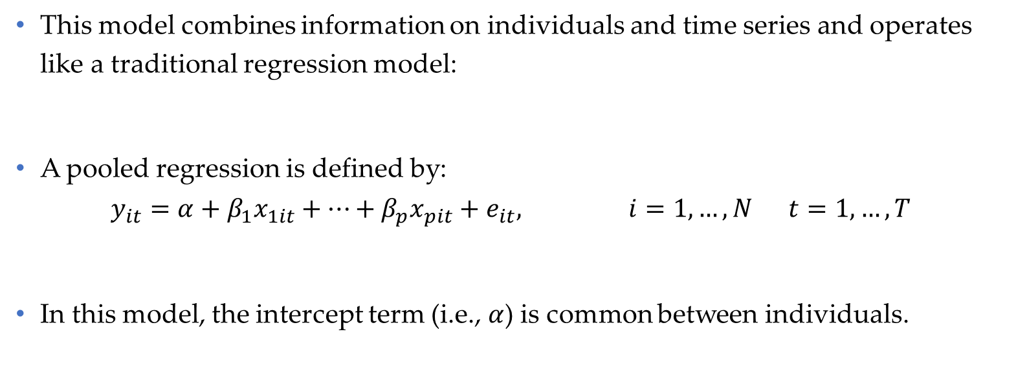
Pooled regression
This model combines information on individuals and time series and operates like a traditional regression model:
A pooled regression is defined by:
$$y_{it}=α+β_{1}x_{1it}+…+β_{p}x_{pit}+e_{it}, i=1,…,N t=1,…,T$$
In this model, the intercept term (i.e., $α$) is common between individuals.
Econometrics 2: Panel data models
University of Glasgow
2022-2023

Slide 5
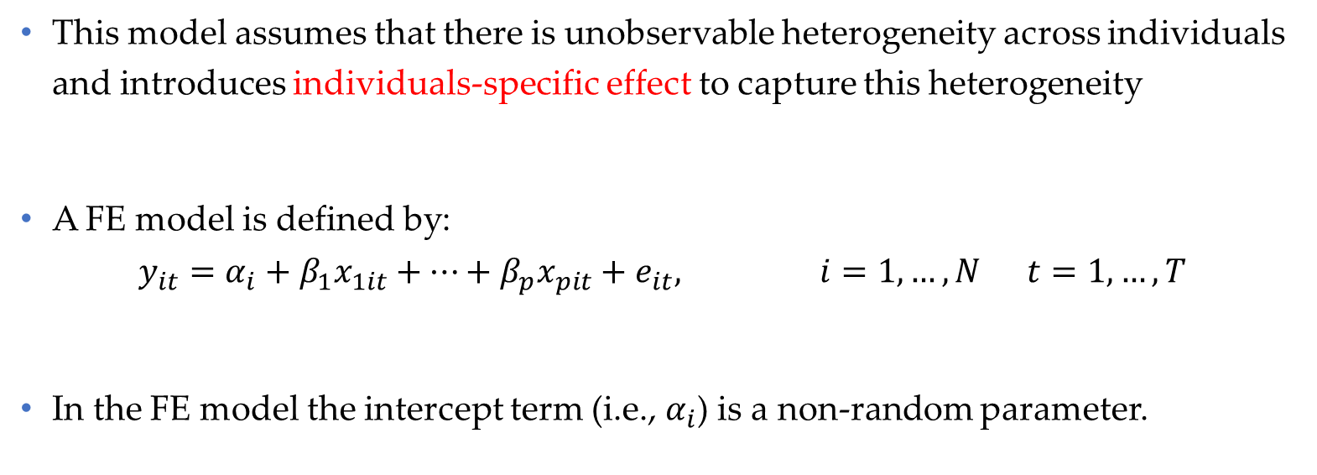
Fixed effects (FE) model
This model assumes that there is unobservable heterogeneity across individuals and introduces individuals-specific effect to capture this heterogeneity
A FE model is defined by:
$$y_{it}=α_{i}+β_{1}x_{1it}+…+β_{p}x_{pit}+e_{it}, i=1,…,N t=1,…,T$$
In the FE model the intercept term (i.e., $α_{i}$) is a non-random parameter.
Econometrics 2: Panel data models
University of Glasgow
2022-2023

Slide 6
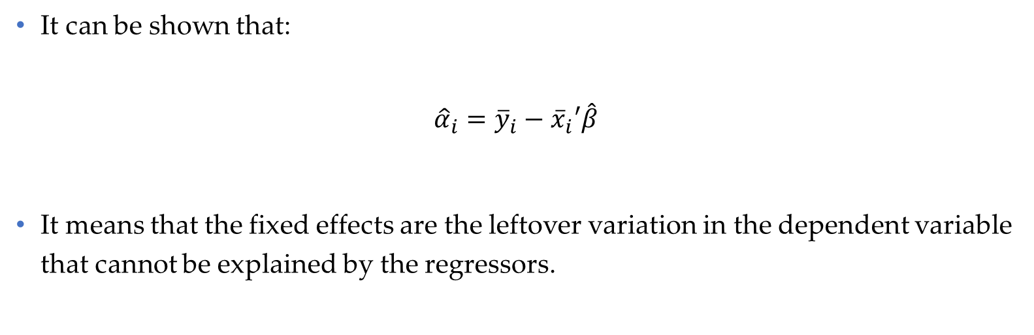
Fixed effects (FE) model –(Cont’d)
It can be shown that:
$${\hat{α}}_{i}={\overline{y}}_{i}−{\overline{x}}_{i}′\hat{β}$$
It means that the fixed effects are the leftover variation in the dependent variable that cannot be explained by the regressors.
Econometrics 2: Panel data models
University of Glasgow
2022-2023

Slide 7
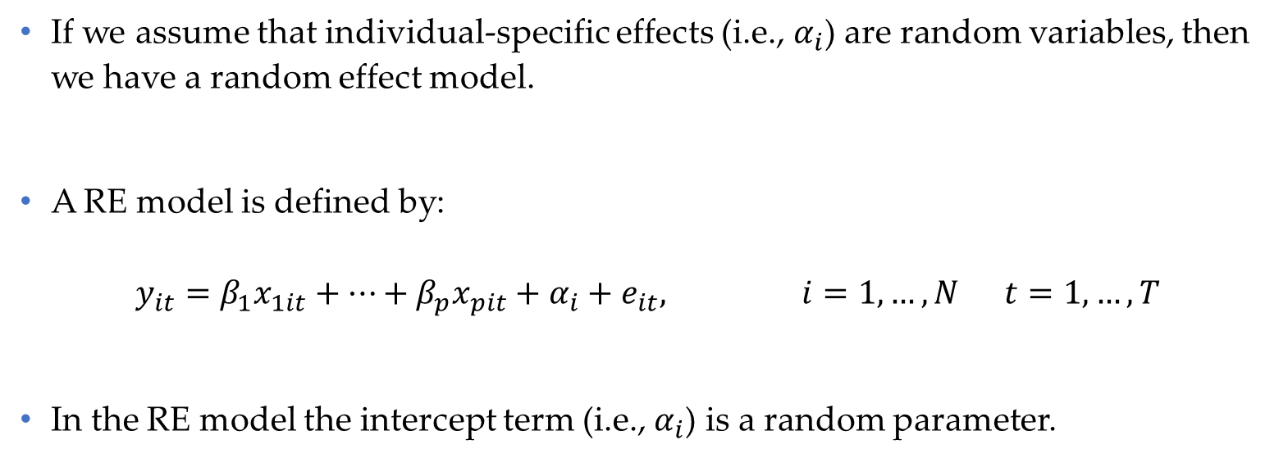
Random effects (RE) model
If we assume that individual-specific effects (i.e., $α_{i}$) are random variables, then we have a random effect model.
A RE model is defined by:
$$y_{it}=β_{1}x_{1it}+…+β_{p}x_{pit}+α_{i}+e_{it}, i=1,…,N t=1,…,T$$
In the RE model the intercept term (i.e., $α_{i}$) is a random parameter.
Econometrics 2: Panel data models
University of Glasgow
2022-2023

Slide 8
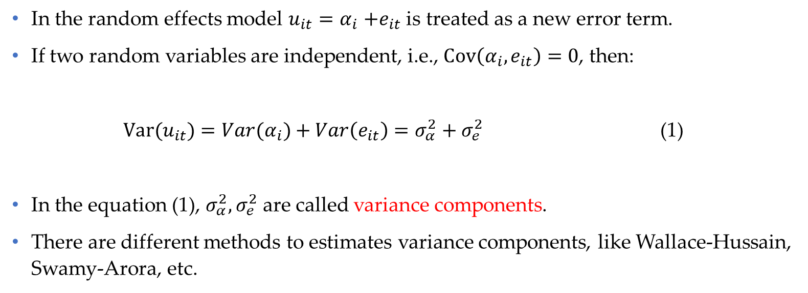
Random effects (RE) model – (Cont’d)
In the random effects model $u_{it}{=α}_{i}+e_{it}$ is treated as a new error term.
If two random variables are independent, i.e., $Cov\left(α_{i},e_{it}\right)=0$, then:
${Var(u}_{it}){=Var(α}_{i})+Var\left(e_{it}\right)=σ_{α}^{2}+σ_{e}^{2}$ (1)
In the equation (1), $σ_{α}^{2}, σ_{e}^{2}$ are called variance components.
There are different methods to estimates variance components, like Wallace-Hussain, Swamy-Arora, etc.
Econometrics 2: Panel data models
University of Glasgow
2022-2023

Slide 9
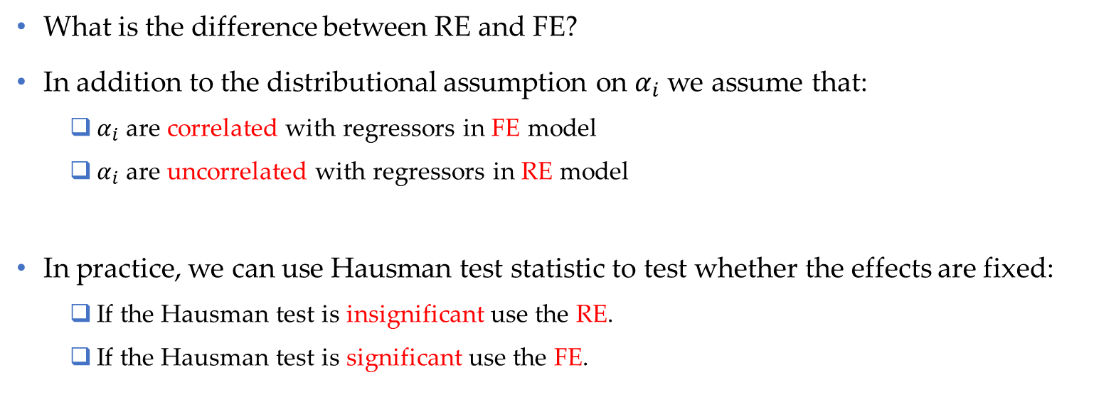
FE vs. RE
What is the difference between RE and FE?
In addition to the distributional assumption on $α_{i}$ we assume that:
$α_{i}$are correlated with regressors in FE model
$α_{i}$are uncorrelated with regressors in RE model
In practice, we can use Hausman test statistic to test whether the effects are fixed:
If the Hausman test is insignificant use the RE.
If the Hausman test is significant use the FE.
Econometrics 2: Panel data models
University of Glasgow
2022-2023

Slide 10
Time effects
So far, we consider only individual specific effects in the model.
These models are called one-way models.
We can add time effects to each of the previous models. In this case, we would have two-way panel data models.
Econometrics 2: Panel data models
University of Glasgow
2022-2023

Slide 11
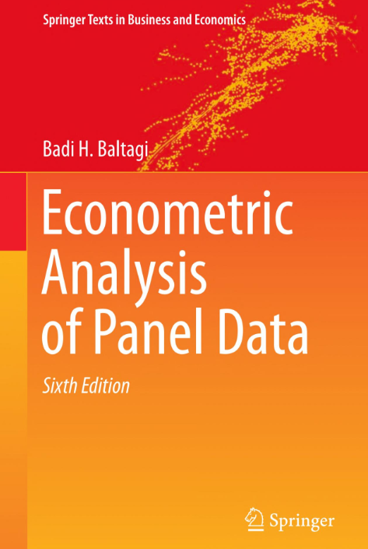
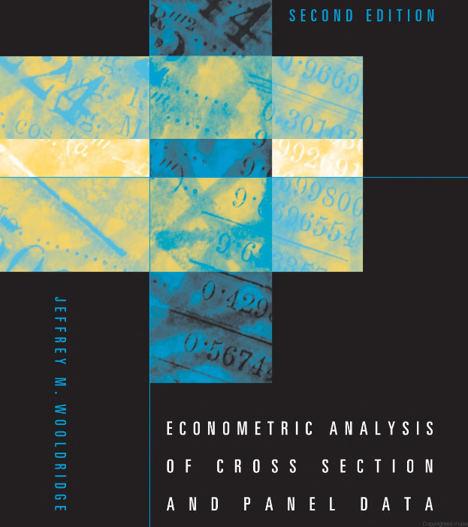
Bibliography
Wooldridge, J. M. (2010). Econometric analysis of cross section and panel data. MIT press.
Baltagi, B.H. (2021). Econometrics Analysis of Panel Data. sixth Ed. Springer.
Econometrics 2: Panel data models
University of Glasgow
2022-2023

